Slide 1
Introduction to Compilers
Lecture 1
Ying Weiqin (应伟勤)
yingweiqin@scut.edu.cn

Slide 2
Outline
1 Course Information
2 The History of Programming Languages and Compilers
3 The Structure of a Compiler
4 Language Process
2
Notes:
2

Slide 3
A Short History of Compilers and Programming Languages
First, there was nothing.
Then, there was machine code.
Then, there were assembly languages.
Programming expensive: 50% of costs for machines went into programming.

Slide 4
History of High-Level Languages
Initially, programs “hard-wired” or entered electro-mechanically: Analytical Engine, ENIAC, punched-card-handling machines
Programs encoded as numbers (machine language) stored as data: Manchester Mark I, EDSAC.
In 1952 Grace Hopper had an operational compiler. "Nobody believed that," she said. "I had a running compiler and nobody would touch it. They told me computers could only do arithmetic."
All programming done in assembly
Problem: Software costs exceeded hardware costs!

Slide 5
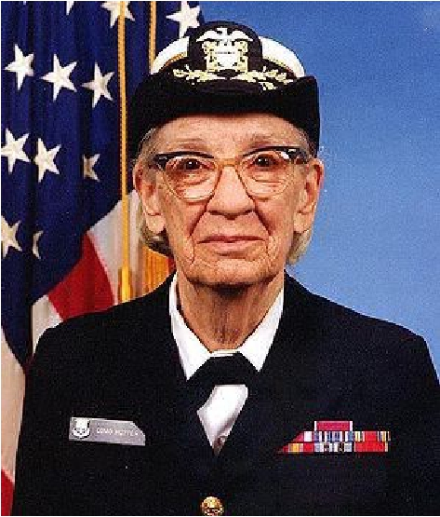
High-Level Languages
Rear Admiral Grace Hopper, inventor of A-0, COBOL, and the term “compiler.”
Image: http://upload.wikimedia.org/wikipedia/commons/thumb/5/55/Grace_Hopper.jpg/300px-Grace_Hopper.jpg

Slide 6
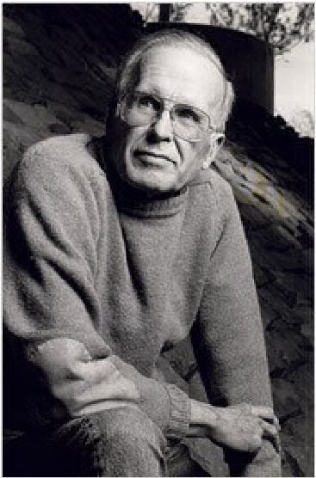
High-Level Languages
John Backus, team lead on FORTRAN.
Image: http://upload.wikimedia.org/wikipedia/commons/thumb/5/55/Grace_Hopper.jpg/300px-Grace_Hopper.jpg
http://www.nytimes.com/2007/03/20/business/20backus.html

Slide 7
FORTRAN I
John Backus
Idea: translate high-level code to assembly
Many thought this impossible
1954-7 FORTRAN I project
By 1958, >50% of all software is in FORTRAN
Cut development time dramatically (2 wks to 2 hrs)
The first compiler
Produced code almost as good as hand-written
Huge impact on computer science
Led to an enormous body of theoretical work
Modern compilers preserve the outlines of FORTRAN I

Slide 8
The 60s Language Explosion
APL (arrays), SNOBOL (strings), and many more.
1967-68: Simula 67, first “object-oriented” language.
Algol 68: Combines FORTRANish numerical constructs, COBOLish records, pointers, all described in rigorous formalism. Remnants remain in C, but Algol 68 deemed too complex.
1968: “Software Crisis” announced. Trend towards simpler languages: Pascal, C

Slide 9
The 1970s
Emphasis on “methodology”: modular programming.
Mid 1970’s: Prolog. Declarative logic programming.
Late 1970’s: Department of Defense (DoD) starts to develop Ada to consolidate >500 languages.

Slide 10
And on into the present
Complexity increases with C++.
Then decreases with Java.
Specialized languages and scripting languages: HTML, Python, …

